Slide 1
Internship Summary Report
supervisor：Harry Mou
Mingyuan Chi
User Portrait Group
Strategy Operations Center

Slide 2

About me
Huazhong University of Science & Technology
Bsc. Computer Science
Research Area：Graph Neural Network
Computer Vision
Deep Learning Compiler
Notes:
首先来做一个简单的自我介绍
我目前就读于华中科技大学计算机学院
主要研究方向包括图神经网络、计算机视觉网络结构、第三代基因测序

Slide 3
Conclusion
Result&
Future
Plan&
Immplementation
Project Introdution
Notes:
接下来我们正式开始，我将从一下四个方面来进行我的实习总结
分别是。。。

Slide 4
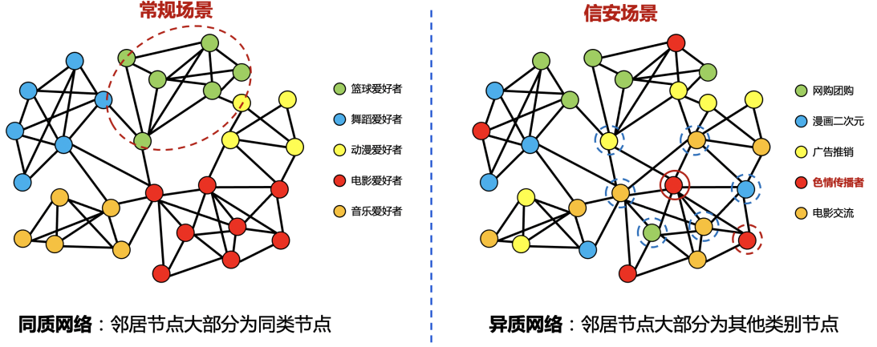
Background
For social networks, there is a lot of noise in the directly observed structure (high heterogeneity) and users in the same category tend to be unfocused, leading to the unsatisfactory application of graph neural networks
Therefore, the graph needs to be optimized to obtain better results for the application of graph neural networks
Notes:
首先我们不妨从一个具体的例子出发
在我们的业务中经常会遇到这样的社交网络
右侧是我们观测到的社交网络
左侧是我们期望的网络
节点：用户
边：好友、共同关注

Slide 5
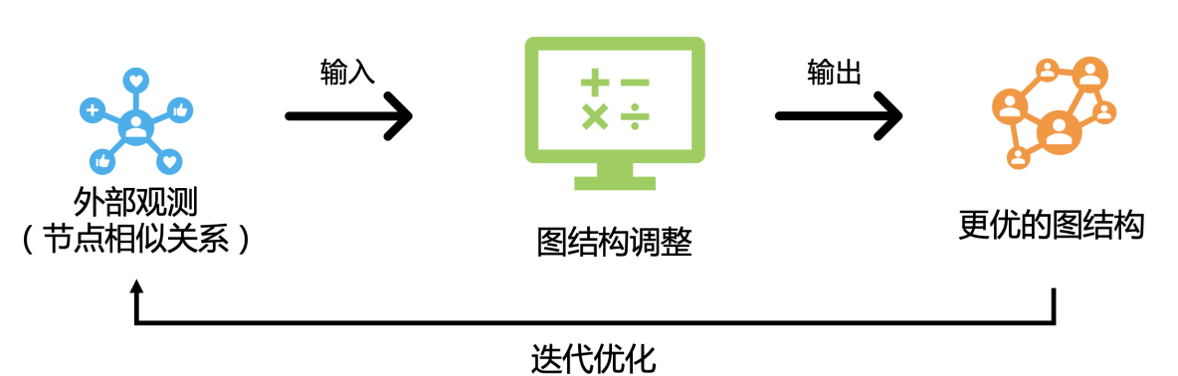
Background
Graph topology optimization neural network (GEN) can optimize the structure of graphs very well, but due to its
1. The huge time-space complexity 𝑂(𝑛^2 ) is difficult to apply for large graphs
2. Need labels for some nodes, but many datasets do not have labels
Therefore, the following improvements are needed
Reduce time-space complexity
Improved to unsupervised version
Ruijia W, Shuai M. Graph Structure Estimation Neural Networks[J]. Proceedings of the Web Conference ,2021:342-353
Notes:
GEN能使得同种用户更加集中
对于QQ群，${10}^{9}$数量级的图，开销在${10}^{18}$，远超想象
有些业务没有标签，而且人工标签存在粗糙、错误的情况

Slide 6
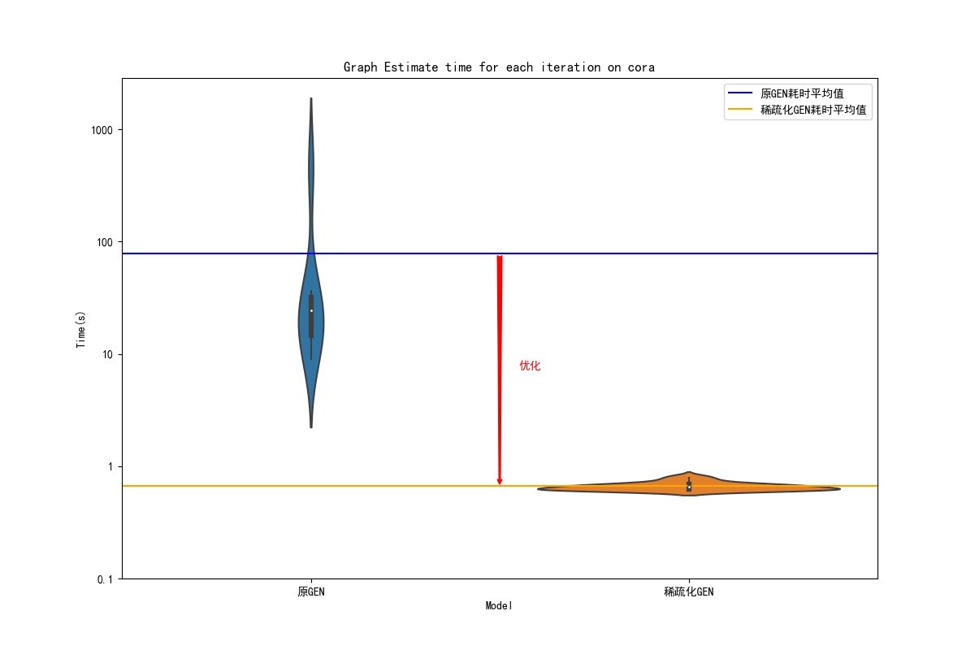
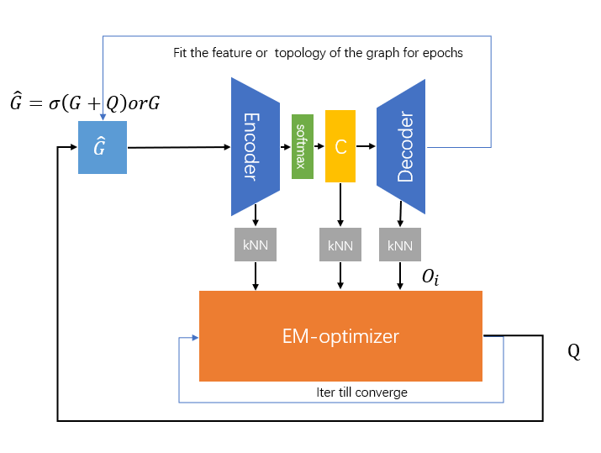
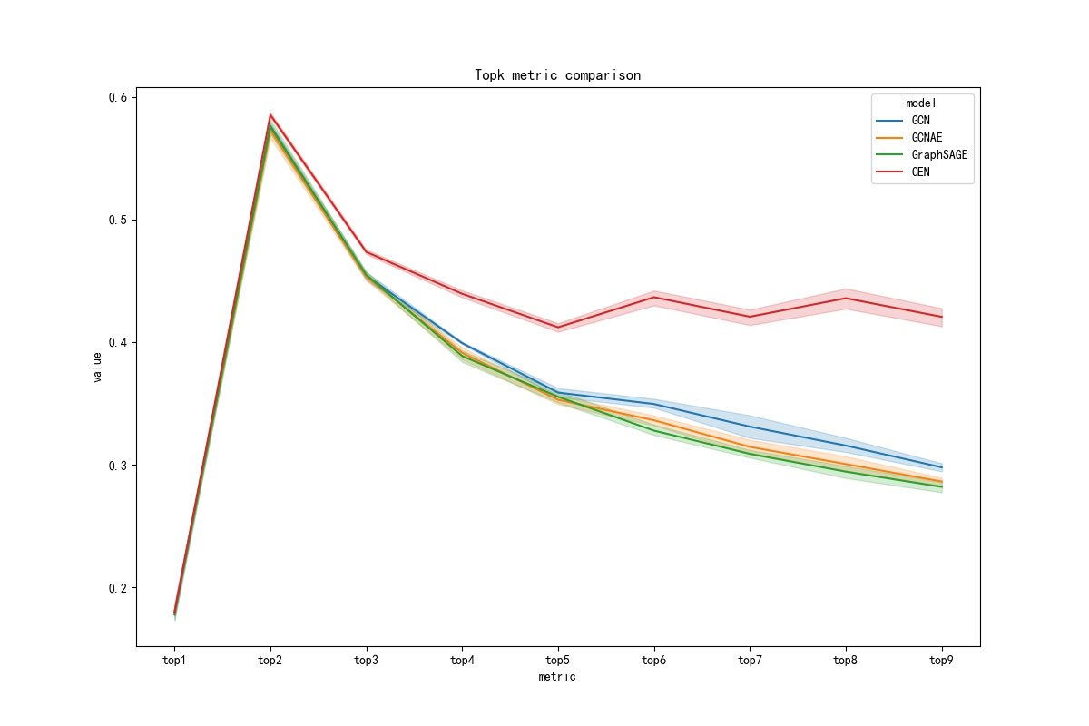
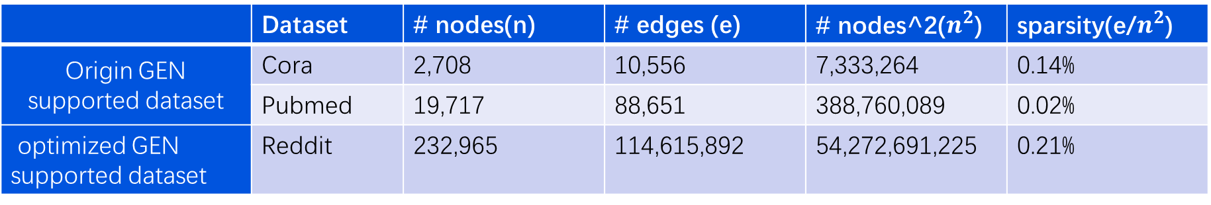
Result Overview
Optimized GEN memory overhead reduced to 1 in 1,000, 15x speedup
Unsupervised GEN version with better results than baseline
 | Dataset | # nodes(n) | # edges (e) | # nodes^2($n^{2}$) | sparsity(e/$n^{2}$)
Origin GEN supported dataset | Cora | 2,708 | 10,556 | 7,333,264 | 0.14%
 | Pubmed | 19,717 | 88,651 | 388,760,089 | 0.02%
optimized GEN supported dataset | Reddit | 232,965 | 114,615,892 | 54,272,691,225 | 0.21%
Notes:
针对以上两点我在这段时间内取得了一些初步的成果
这里展示的是成果的概况
在后面我们会详细介绍

Slide 7
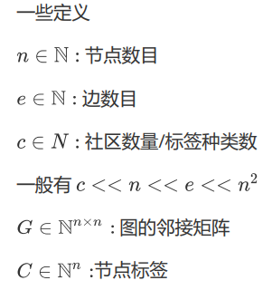
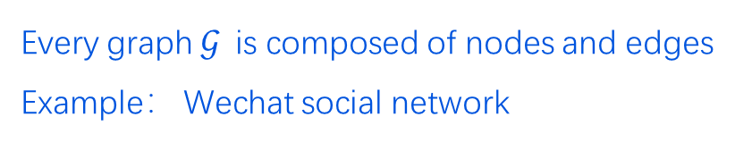
What is Graph?
Every graph$𝒢$ is composed of nodes and edges
Example： Wechat social network
Image from harry mou. 黑产看了会落泪! 万字解密图算法技术在黑产挖掘中的应用与创新[R],2021
Notes:
图是一切的基础，我们来理解一下什么是图
社交网络
节点之间存在关系

Slide 8
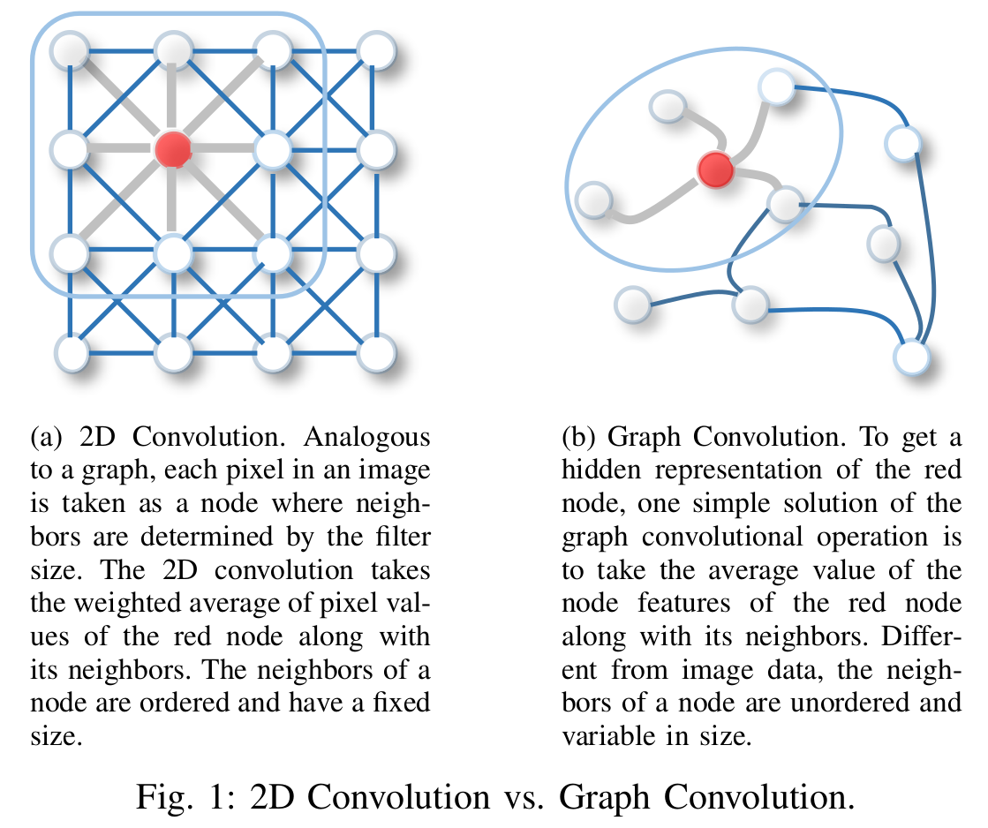
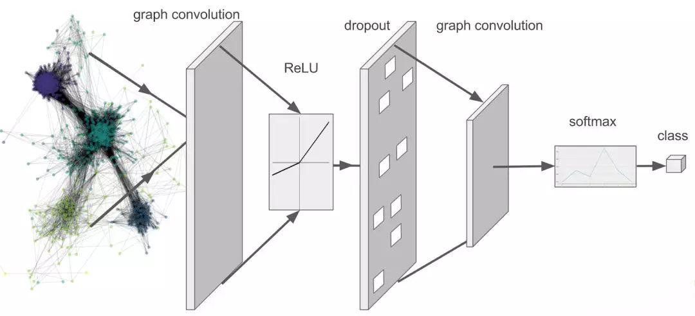
What is Graph Convulsion
Application：
Classify social network users, e.g., animation fans, movie lovers
Prediction of user relationships e.g. friendships, kinships
…
图片来自 Wu, Zonghan and Pan, Shiru. A Comprehensive Survey on Graph Neural Networks [J]. IEEE Transactions on Neural Networks and Learning Systems, 2021:4-24
Notes:
图卷积是对欧几里得空间卷积的拓扑扩展
常规的计算机视觉中的卷积只能用于网格状数据
但是图卷积可以应用于任何拓扑结构的图数据
Conv2d 欧几里得空间
graphConv 拓扑空间
社交网络~qq~微信

Slide 9
Project Introduction
GEN
Notes:
接下来就到了我们的主角了GEN

Slide 10
Dive into GEN
Graph structure Estimation neural Network
For a noisy input graph$G$，a relatively accurate optimized graph$\hat{G}$ is obtained such that $f\left(\hat{G};θ\right)$ outperforms $f(G;θ)$
Image from Harry Mou. 黑产看了会落泪! 万字解密图算法技术在黑产挖掘中的应用与创新[R],2021

Slide 11
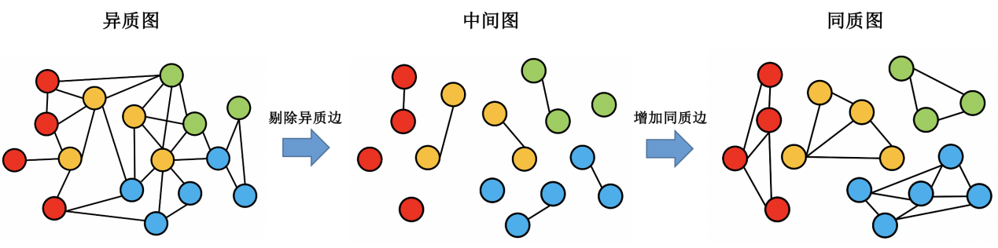
Dive into GEN
Generic diagram optimization framework:
A better diagram!
Graph structure Estimation neural Network
For a noisy input graph$G$，a relatively accurate optimized graph$\hat{G}$ is obtained such that $f\left(\hat{G};θ\right)$ outperforms $f(G;θ)$
图片来自 牟帅. 黑产看了会落泪! 万字解密图算法技术在黑产挖掘中的应用与创新[R],2021
Notes:
总而言之，一句话概括它的作用：它是是为了一个更好的图

Slide 12
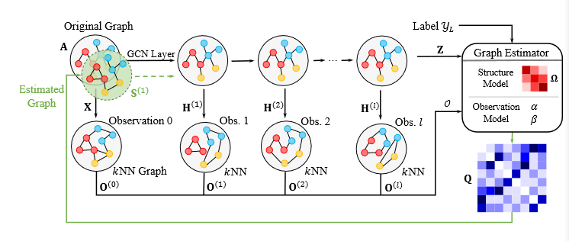
Dive into GEN
Image from Ruijia W, Shuai M. Graph Structure Estimation Neural Networks[J]. Proceedings of the Web Conference ,2021:342-353
Notes:
图经过多层GCN获得高维向量嵌入

Slide 13
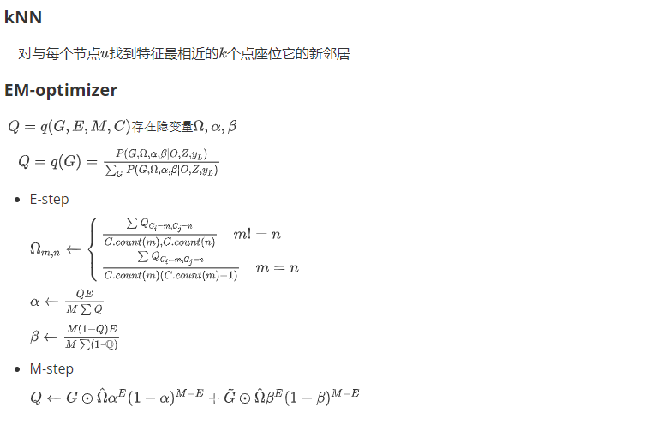
Dive into GEN
Image from Ruijia W, Shuai M. Graph Structure Estimation Neural Networks[J]. Proceedings of the Web Conference ,2021:342-353
Notes:
通过向量之间的距离生成kNN图

Slide 14
Dive into GEN
Image from Ruijia W, Shuai M. Graph Structure Estimation Neural Networks[J]. Proceedings of the Web Conference ,2021:342-353
Notes:
通过观测到的图进行优化
Omeg是社区之间的关系，
例如 中国人对美国人的关系就是相似的
Alpha 和 beta在后面会提及

Slide 15
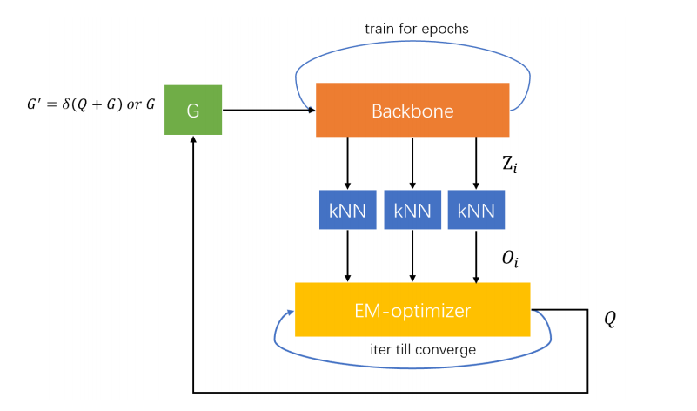
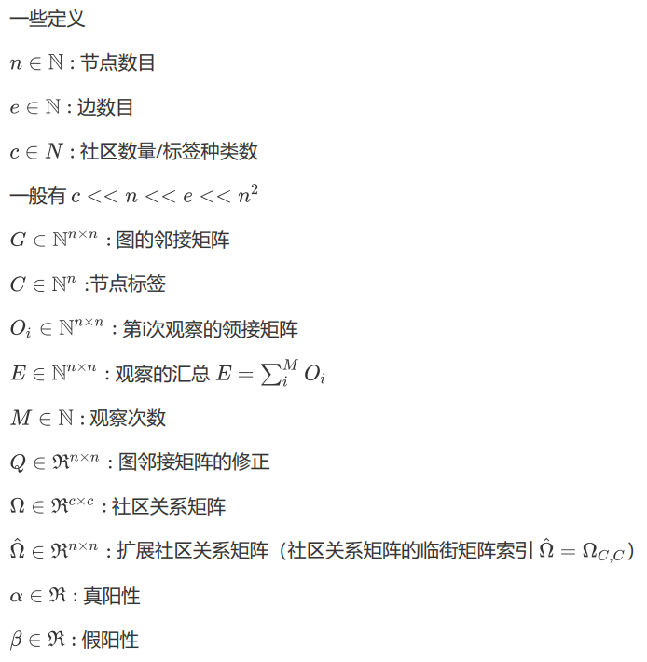
Dive into GEN
Notes:
EM-optimizer ~ Graph Optimizer
对于任何凹函数都是收敛的
Jensen
再看到右下角，alpha，beta分别为真阳性和假阳性
举个例子，就是得了新冠也测出来了叫真阳性；没的新冠但是测出来有叫假阳性

Slide 16


Dive into GEN
$$O(n^{2})$$
$$O(n^{2})$$
Notes:
GEN的复杂度主要在kNN步骤和EM优化步骤

Slide 17
Dive into GEN
Notes:
kNN和EM两个步骤的具体算法如下
因为图的优化邻接矩阵Q的计算存在三个隐变量，因此可以使用EM算法进行优化
kNN因为其中每两个都需要计算一次所以时O(n^2)
Q因为全非0，为稠密矩阵所以复杂度时O(n^2)
EM 对 凹函数都收敛-》Jensen不等式证明

Slide 18
Conclusion
Result&
Future
Plan&
Immplementation
Project Introdution

Slide 19
Conclusion
Result&
Future
Plan&
Immplementation
Project Introdution
Notes:
在大致了解了项目后，来看一下方案与实现

Slide 20
Plan&
Implementation
nn-descend
KNN optimize
Opt GEN
monotonicity
EM
optimize
Matrix compression
JIT
architecture
GraphAutoEncoder
Unsup GEN
metric
Topk
Notes:
主要分为模块，
第一块，优化GEN，具体需要对KNN和EM进行优化
第二块，将GEN无监督华，需要一个新的结构与新的衡量标准

Slide 21
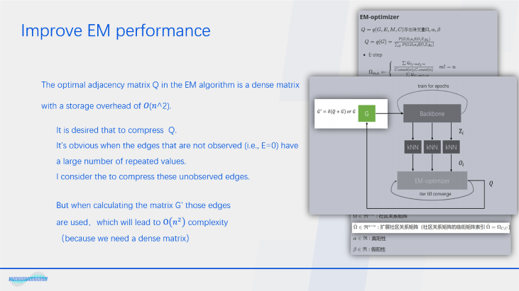
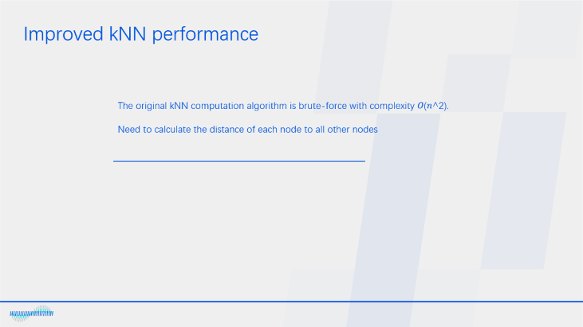
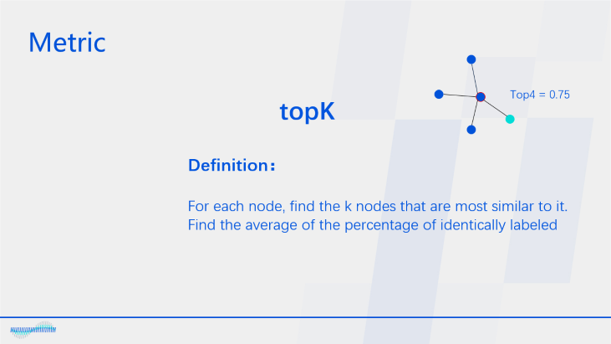
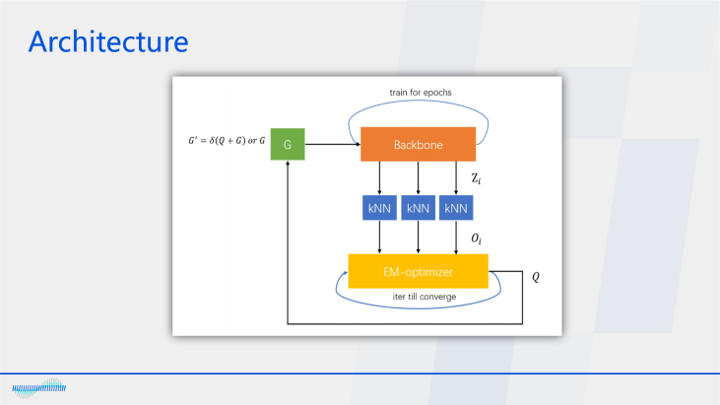
Plan&
Implementation
Opt GEN
Unsup GEN

Slide 22
Improved kNN performance
The original kNN computation algorithm is brute-force with complexity 𝑂(𝑛^2).
Need to calculate the distance of each node to all other nodes
Notes:
优化GEN第一步：改进kNN性能

Slide 23

Improved kNN performance
$$O(n^{2})→O(n^{1.13})$$
The original kNN computation algorithm is brute-force with complexity 𝑂(𝑛^2).
Need to calculate the distance of each node to all other nodes
After investigation the nn-descend algorithm was found with complexity 𝑂(𝑛^1.13).
Using nn-descend instead of the original brute-force algorithm

Slide 24
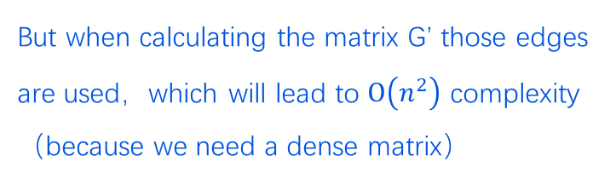
Improve EM performance
The optimal adjacency matrix Q in the EM algorithm is a dense matrix with a storage overhead of 𝑂(𝑛^2).
It is desired that to compress Q.
It’s obvious when the edges that are not observed (i.e., E=0) have a large number of repeated values.
I consider the to compress these unobserved edges.
But when calculating the matrix G’ those edges are used，which will lead to $O\left(n^{2}\right)$ complexity（because we need a dense matrix）
Notes:
第二步：改进
这里可能有点复杂
在之前我们知道Q是稠密矩阵，但是其中有很多重复值，因此接下来对这些重复值进行压缩
Sigma是大于阈值取1小于取0

Slide 25
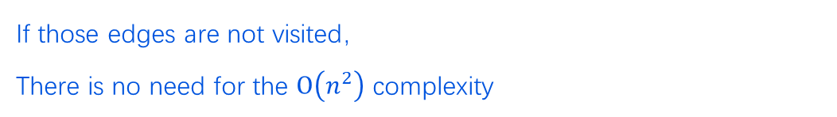
Improve EM performance
If those edges are not visited，
There is no need for the $O\left(n^{2}\right)$ complexity
In the following I’ll do research on the relation between matrix Q and matrix E
Notes:
稠密矩阵-》 O（n^2）

Slide 26
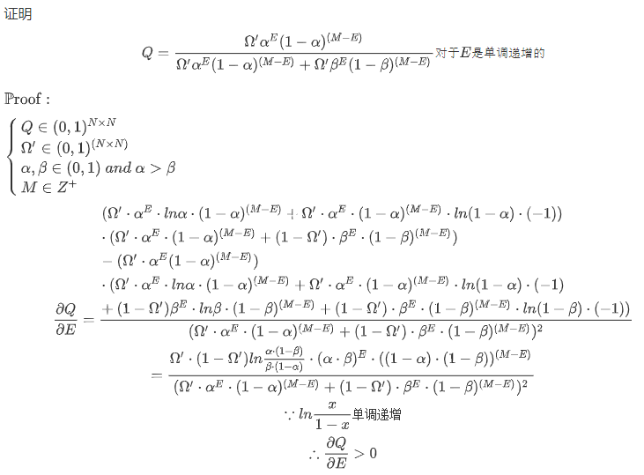
Improve EM performance
If those edges are not visited，
There is no need for the $O\left(n^{2}\right)$ complexity
In the following I’ll do research on the relation between matrix Q and matrix E
Notes:
稠密矩阵-》 O（n^2）

Slide 27
Improve EM performance
If those edges are not visited，
There is no need for the $O\left(n^{2}\right)$ complexity
In the following I’ll do research on the relation between matrix Q and matrix E
It can be found that Q is monotonically increasing to E ，
In other words, the higher the number of observations the more likely it is to appear in the new optimized graph ，
Therefore edges that are not observed do not appear in the optimization graph.
Therefore the compressed matrix does not need to be decompressed.
Notes:
稠密矩阵-》 O（n^2）

Slide 28
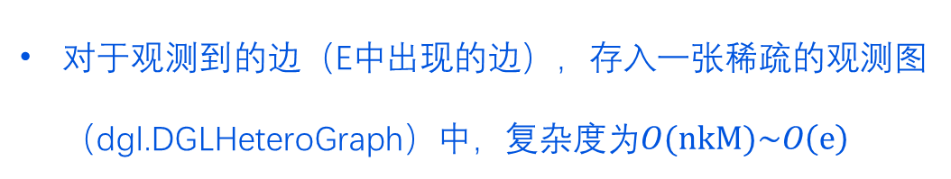
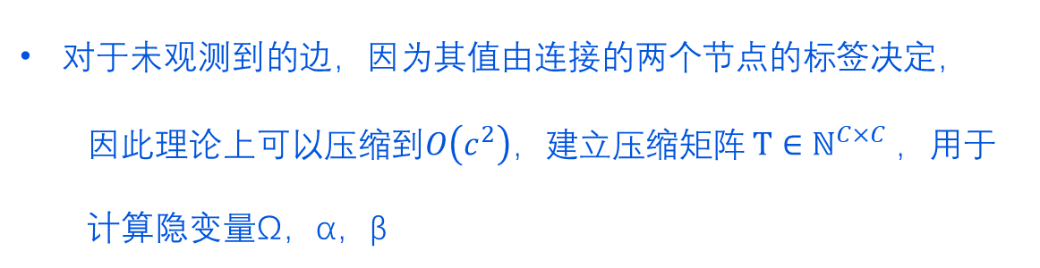
Improve EM performance
对于观测到的边（E中出现的边），存入一张稀疏的观测图（dgl.DGLHeteroGraph）中，复杂度为$O(nkM)\sim O\left(e\right)$
对于未观测到的边，因为其值由连接的两个节点的标签决定，
因此理论上可以压缩到$O\left(c^{2}\right)，$建立压缩矩阵 $T∈ℕ^{C×C}$，用于计算隐变量Ω，α，β
Notes:
稠密矩阵-》 O（n^2）
Alpha，beta只是对Q求和，因此只用T记录每个相同值出现次数即可，然后乘以相应位置对应的值
Omega复杂一点，需要特定行列求和，因此只用找到T中相应行列的位置取出来即可

Slide 29

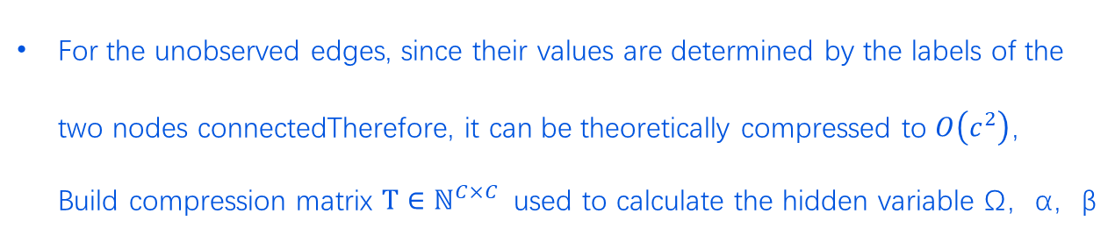
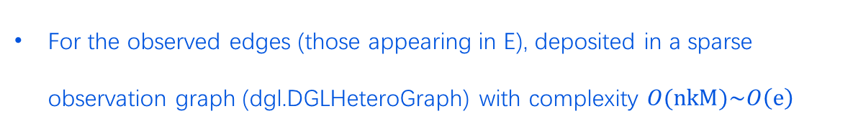
Improve EM performance
$$O(n^{2})→O(e)$$
For the observed edges (those appearing in E), deposited in a sparse observation graph (dgl.DGLHeteroGraph) with complexity $O(nkM)\sim O\left(e\right)$
For the unobserved edges, since their values are determined by the labels of the two nodes connectedTherefore, it can be theoretically compressed to $O\left(c^{2}\right)，$ Build compression matrix $T∈ℕ^{C×C}$ used to calculate the hidden variable Ω，α，β
However, in compression$, O\left(nc\right)$ traversal is required
Using JIT (Just In Time compile) technology, the performance of this part of the code is close to that of compiled languages (c,go,rust...)The speedup of this loop section is almost 100x
Notes:
众所周知 Python的循环是迭代器实现的，因此非常慢
这里使用JIT技术，直接在运行该段代码时将该段代码编译为机器代码

Slide 30
Architecture
Notes:
介绍完第一个模块后，接下来介绍第二个模块：无监督GEN
这是原版的GEN

Slide 31
Architecture
Notes:
这是无监督版本的GEN
无监督没有class， 所以就自己创造class
SVD~Autoencoder~PCA 在高维空间找最大的特征值和特征向量
SVD分解复杂度O（n^3）

Slide 32
Metric
Top4 = 0.75
topK
Definition：
For each node, find the k nodes that are most similar to it.
Find the average of the percentage of identically labeled
Notes:
提出新的结构之后需要一种新的指标来衡量无监督学习的好坏
这里我们采用topK

Slide 33
Conclusion
Result&
Future
Plan&
Immplementation
Project Introdution

Slide 34
Result&
Future
Conclusion
Plan&
Immplementation
Project Introdution
Notes:
在了解了方案与实现后接下来具体看一看成果与展望

Slide 35
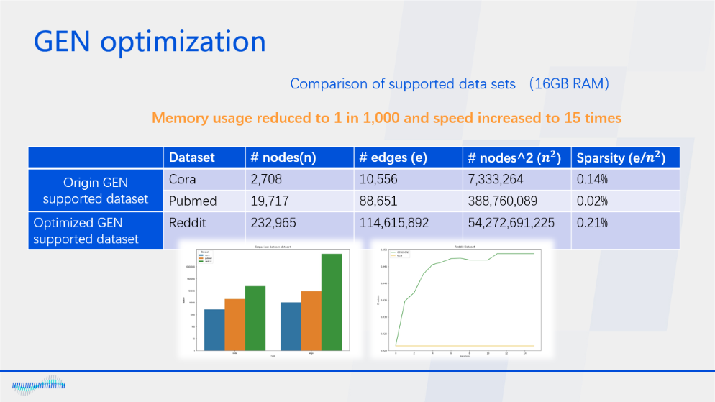
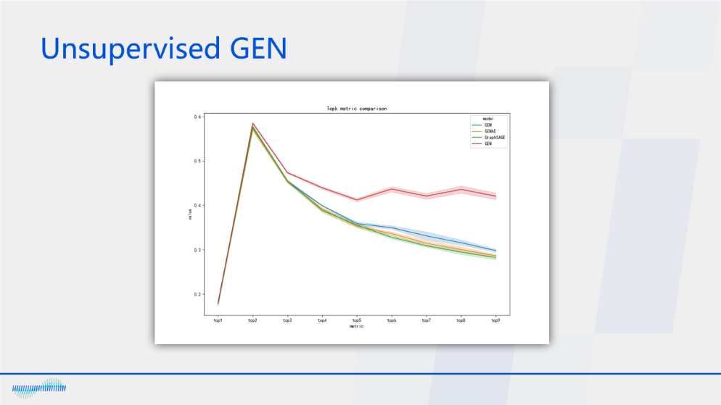
Result&
Future
Notes:
同样也分为两个模块 优化Gen 无监督GEN

Slide 36
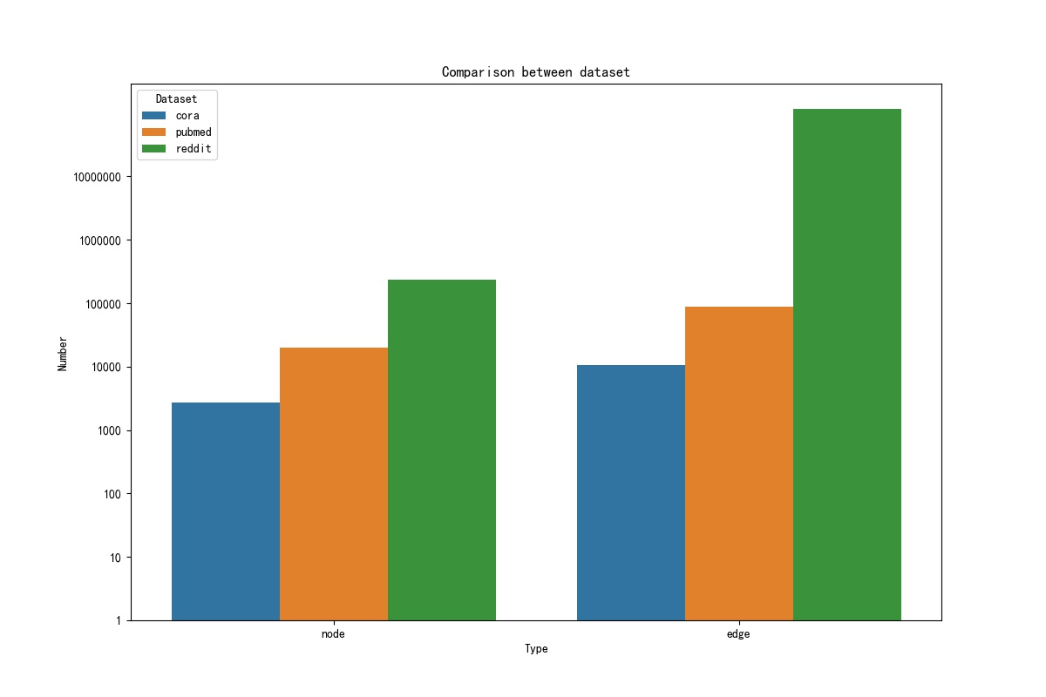
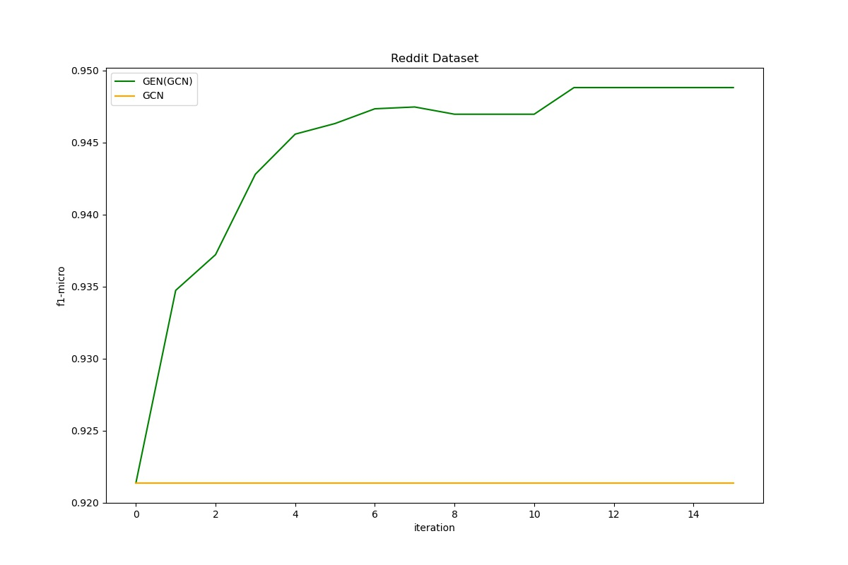
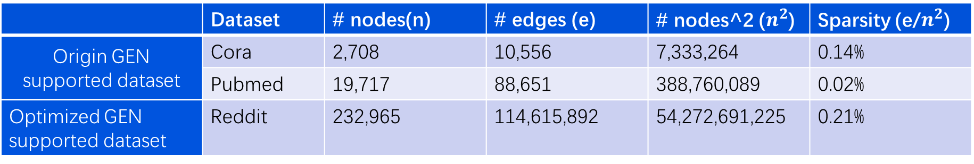
GEN optimization
Comparison of supported data sets （16GB RAM）
Memory usage reduced to 1 in 1,000 and speed increased to 15 times
 | Dataset | # nodes(n) | # edges (e) | # nodes^2 ($n^{2}$) | Sparsity (e/$n^{2}$)
Origin GEN supported dataset | Cora | 2,708 | 10,556 | 7,333,264 | 0.14%
 | Pubmed | 19,717 | 88,651 | 388,760,089 | 0.02%
Optimized GEN supported dataset | Reddit | 232,965 | 114,615,892 | 54,272,691,225 | 0.21%
Notes:
在优化GEN方面可以将内存。。。速度。。。

Slide 37
GEN optimization
Comparison of supported data sets （16GB RAM）
 | Dataset | # nodes(n) | # edges (e) | # nodes^2 ($n^{2}$) | Sparsity (e/$n^{2}$)
Origin GEN supported dataset | Cora | 2,708 | 10,556 | 7,333,264 | 0.14%
 | Pubmed | 19,717 | 88,651 | 388,760,089 | 0.02%
Optimized GEN supported dataset | Reddit | 232,965 | 114,615,892 | 54,272,691,225 | 0.21%

Slide 38
GEN optimization
Comparison of supported data sets （16GB RAM）
 | Dataset | # nodes(n) | # edges (e) | # nodes^2 ($n^{2}$) | Sparsity (e/$n^{2}$)
Origin GEN supported dataset | Cora | 2,708 | 10,556 | 7,333,264 | 0.14%
 | Pubmed | 19,717 | 88,651 | 388,760,089 | 0.02%
Optimized GEN supported dataset | Reddit | 232,965 | 114,615,892 | 54,272,691,225 | 0.21%
Notes:
这张图是将Reddit直接送入GCN与优化Reddit送入GCN的对比，可以发现随着迭代次数的增加，GCN在 优化后的Reddit上的效果越来越好

Slide 39
GEN optimization
Speed comparison
Iteration time reduced by 15x
Notes:
速度上每次迭代用时大幅度减少

Slide 40
Unsupervised GEN
Notes:
无监督GEN也是由于GCN、GraphSAGE等baseline

Slide 41
Current Result
Optimized GEN memory overhead reduced to 1 in 1,000, speed up about 15 times $O(n^{2})→O(e)$
Unsupervised version of GEN, better than baseline （GCN、GraphSAGE、GraphAutoEncoder）
Notes:
来做一个小结吧

Slide 42
Future
A more comprehensive metric is needed to measure the effectiveness of unsupervised GEN
It can be examined from the direction of removing the tags in EM
Some small sample visualizations are needed to visually demonstrate the benefits of GEN
Combining GraphSAINT and GEN can make a big picture optimization training framework
Notes:
虽然取得了一些阶段性的成果，但是任重而道远，首先需要一种。。。，其次去掉。。。，而且也需要。。。最后也可也以结合GraphSAINT

Slide 43
Result&
Future
Conclusion
Plan&
Immplementation
Project Introdution

Slide 44
Conclusion
Result&
Future
Plan&
Immplementation
Project Introdution
Notes:
最后一个方面：个人思考总结

Slide 45
Conclusion
GEN provides a general graph optimization framework that now solves the performance bottleneck of kNN and EM. Backbone bottlenecks can be solved using the GraphSAINT framework Therefore, GEN is now very attractive for applications on large graphs (billion and above)
Anything that can be represented by a graph will eventually be represented by a graph, not just social networks.
Everything, including gene expression, molecular structure, planetary motion, finite element analysis, etc.,
can be represented by graphs. Graphs are topological extensions of the grid and are very expressive and have
potential for use in a wide variety of businesses.

Slide 46
Conclusion
We hope that more business data can be used to verify the superiority of GEN, which itself is a method for heterogeneous graphs in business, and this optimization will hopefully improve the performance and effectiveness of graph neural networks in business.
Communication is very important. Keeping in touch with colleagues and mentors can reduce a lot of unnecessary confusion. Not only in business, they can also give me a lot of guidance in life

Slide 47
参考文献
[1] 牟帅. 黑产看了会落泪! 万字解密图算法技术在黑产挖掘中的应用与创新[R],2021
[2] Ruijia W, Shuai M. Graph Structure Estimation Neural Networks[J]. Proceedings of the Web Conference ,2021:342-353
[3] Santo F, Darko H. Community detection in networks: A user guide[J]. Physics Reports, 2016:1-44
[4] Anton T, John P. Graph Clustering with Graph Neural Networks[J]. CoRR, 2020
[5] Zhongdao W, Liang Z. Linkage Based Face Clustering via Graph Convolution Network[J]. CoRR, 2019
[6] Khan, B, Niazi, M. Network Community Detection: A Review and Visual Survey[J], 2017
[7]皮果提. Community Detection 算法[OL].(2013) https://blog.csdn.net/itplus/article/details/9286905
[8] Thomas N. Kipf,Max W. Semi-Supervised Classification with Graph Convolutional Networks[J]. ICLR, 2017
[9] William L. Hamilton, Rex Y, Jure L. GraphSAGE: Inductive Representation Learning on Large Graphs[J]. NIPS, 2017
[10] Aditya G, Jure L. node2vec: Scalable Feature Learning for Networks[J]. KDD, 2016
[11] Wei D, Moses C, Kai Li. Efficient K-Nearest Neighbor Graph Construction for Generic Similarity Measures[J]. In Proceedings of the 20th international conference on World wide web, 2011
[12] Wu, Zonghan and Pan, Shiru. A Comprehensive Survey on Graph Neural Networks [J]. IEEE Transactions on Neural Networks and Learning Systems ，2021：4-24
[13] Mr.Seven基于社区发现算法和图分析Neo4j解读《权力的游戏》[OL]. https://itimetraveler.github.io/2016/11/21/基于社区发现算法和图分析Neo4j解读《权力的游戏》,2016
[14] Numpy document [OL] https://numpy.org/doc/stable/reference
[15] Pytorch document [OL] https://pytorch.org/docs/stable/index.html
supervisor：Harry Mou
Mingyuan Chi
User Portrait Group
Strategy Operations Center
Notes:
那么我的总结结束了，谢谢大家

Slide 48
附录
需要注意的点
numpy的argpartition是不稳定的( introselect )，pytorch的topk是稳定的
Numpy的rand和torch.rand在种子相同的情况下结果也不同
装了IOA import torch会变慢10x倍
其他的尝试
1. EM-optimizer 改进为 Gradient-optimizer

Slide 49
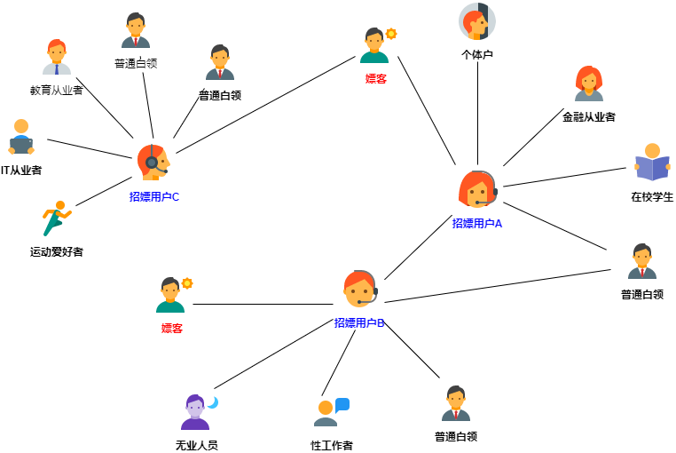
附录
业务相关异构图
图片来自 牟帅. 黑产看了会落泪! 万字解密图算法技术在黑产挖掘中的应用与创新[R],2021

Slide 50
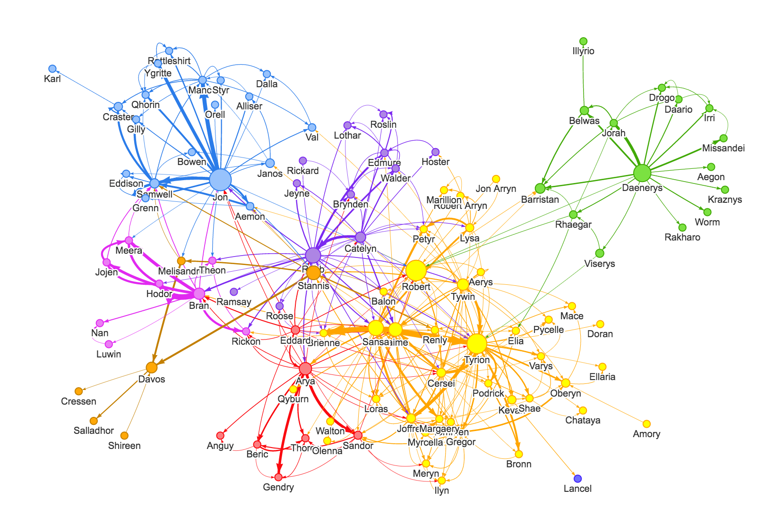
附录
权力的游戏
社交网络
图片来自 Mr.Seven基于社区发现算法和图分析Neo4j解读《权力的游戏》
[OL]. https://itimetraveler.github.io/2016/11/21/基于社区发现算法和图分析Neo4j解读《权力的游戏》,2016

Slide 51
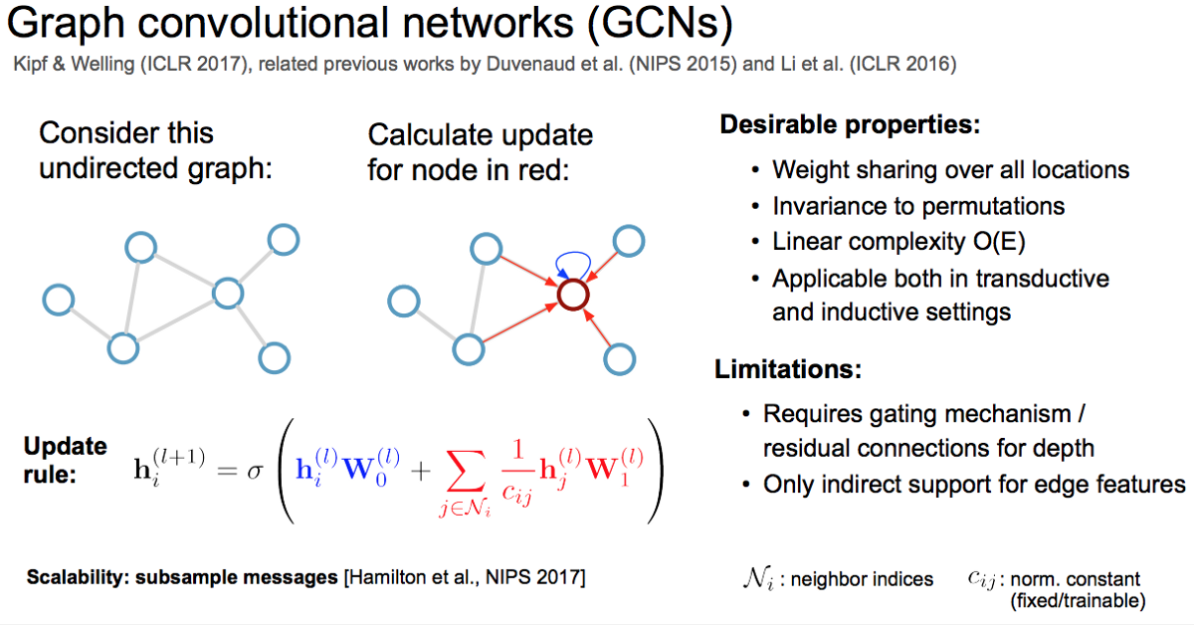
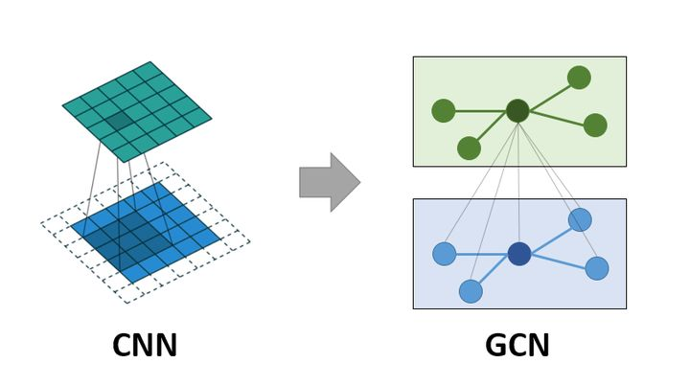
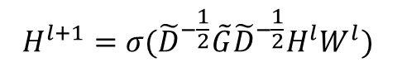
附录
$$H^{l+1}=σ({\tilde{D}}^{−\frac{1}{2}}\tilde{G}{\tilde{D}}^{−\frac{1}{2}}H^{l}W^{l})$$
GCN

Slide 52
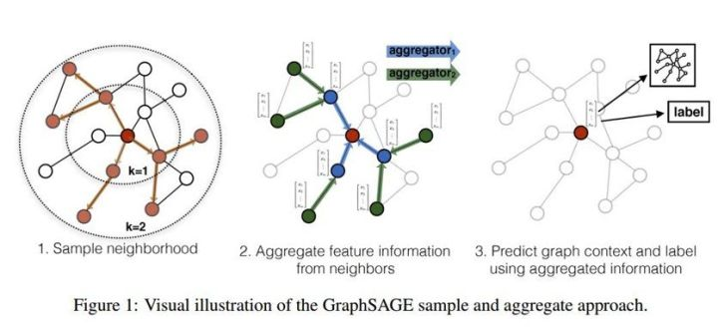
附录
GraphSAGE

Slide 53
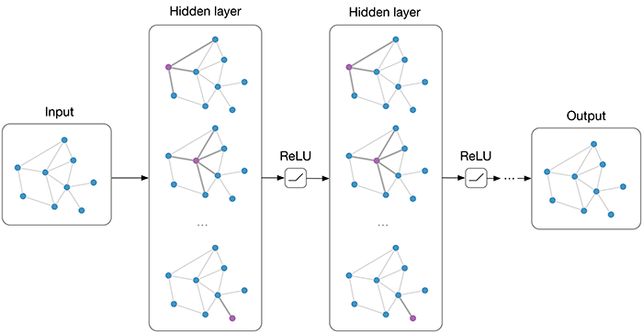
附录
GraphAE

Slide 54
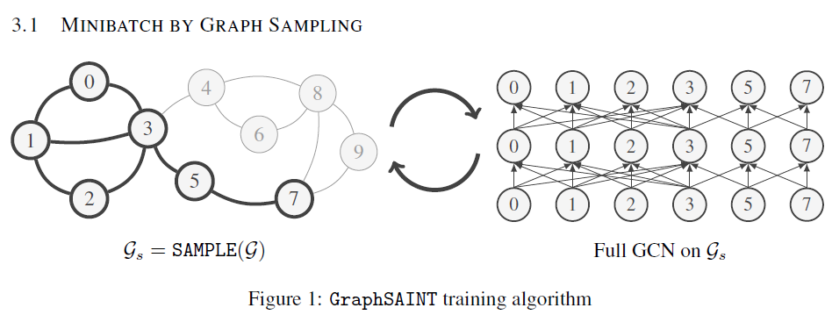
附录
通用大图训练框架
通过随机采样无偏估计大图的框架
GraphSAINT

Slide 55
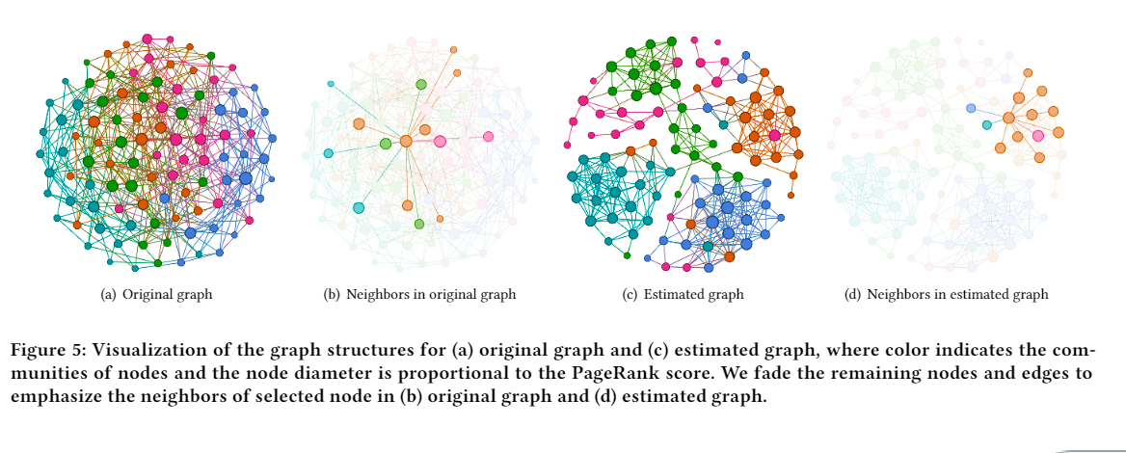
GEN case study
附录

Slide 56
JIT
附录
Just In Time compile
首先由Java的JVM中使用，将热点代码直接编译为机器代码加速运行
Python中应用：Pytorch（torch script），numba（machine code[LLVM]）
内置JIT语言：Java，Julia

Slide 57
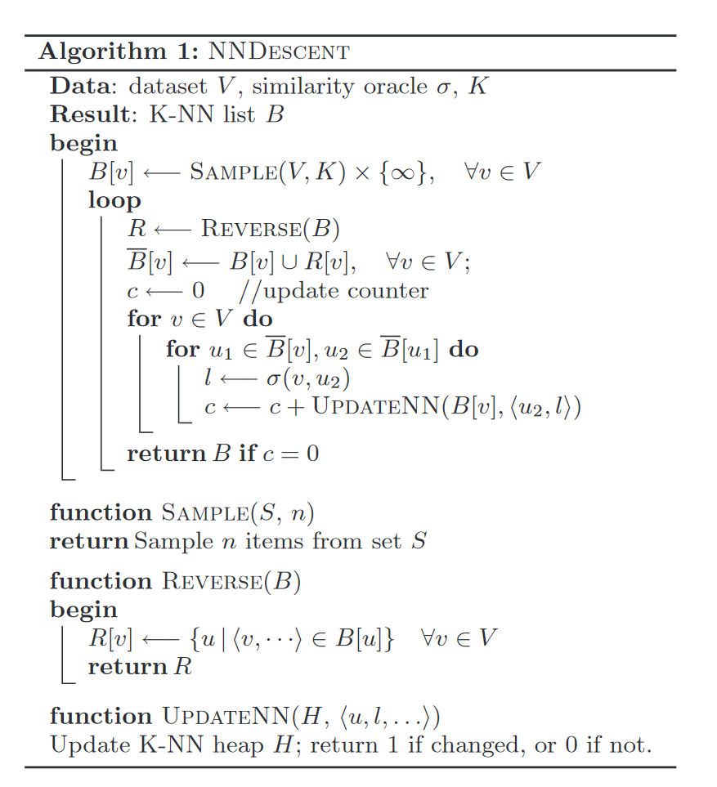
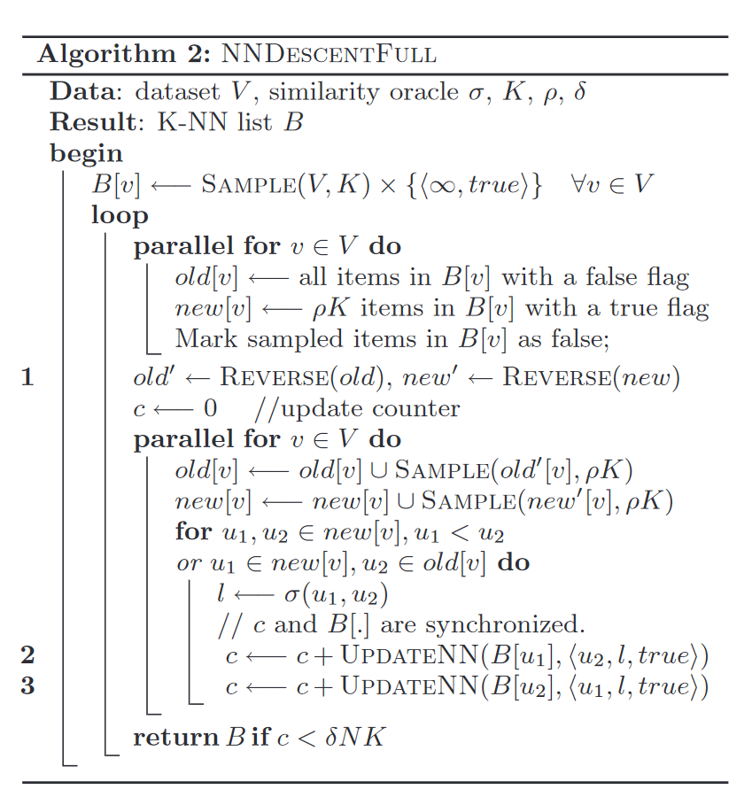
nn-descend
附录
Efficient K-Nearest Neighbor Graph Construction for Generic Similarity Measures

Slide 58
EM
附录

Slide 59
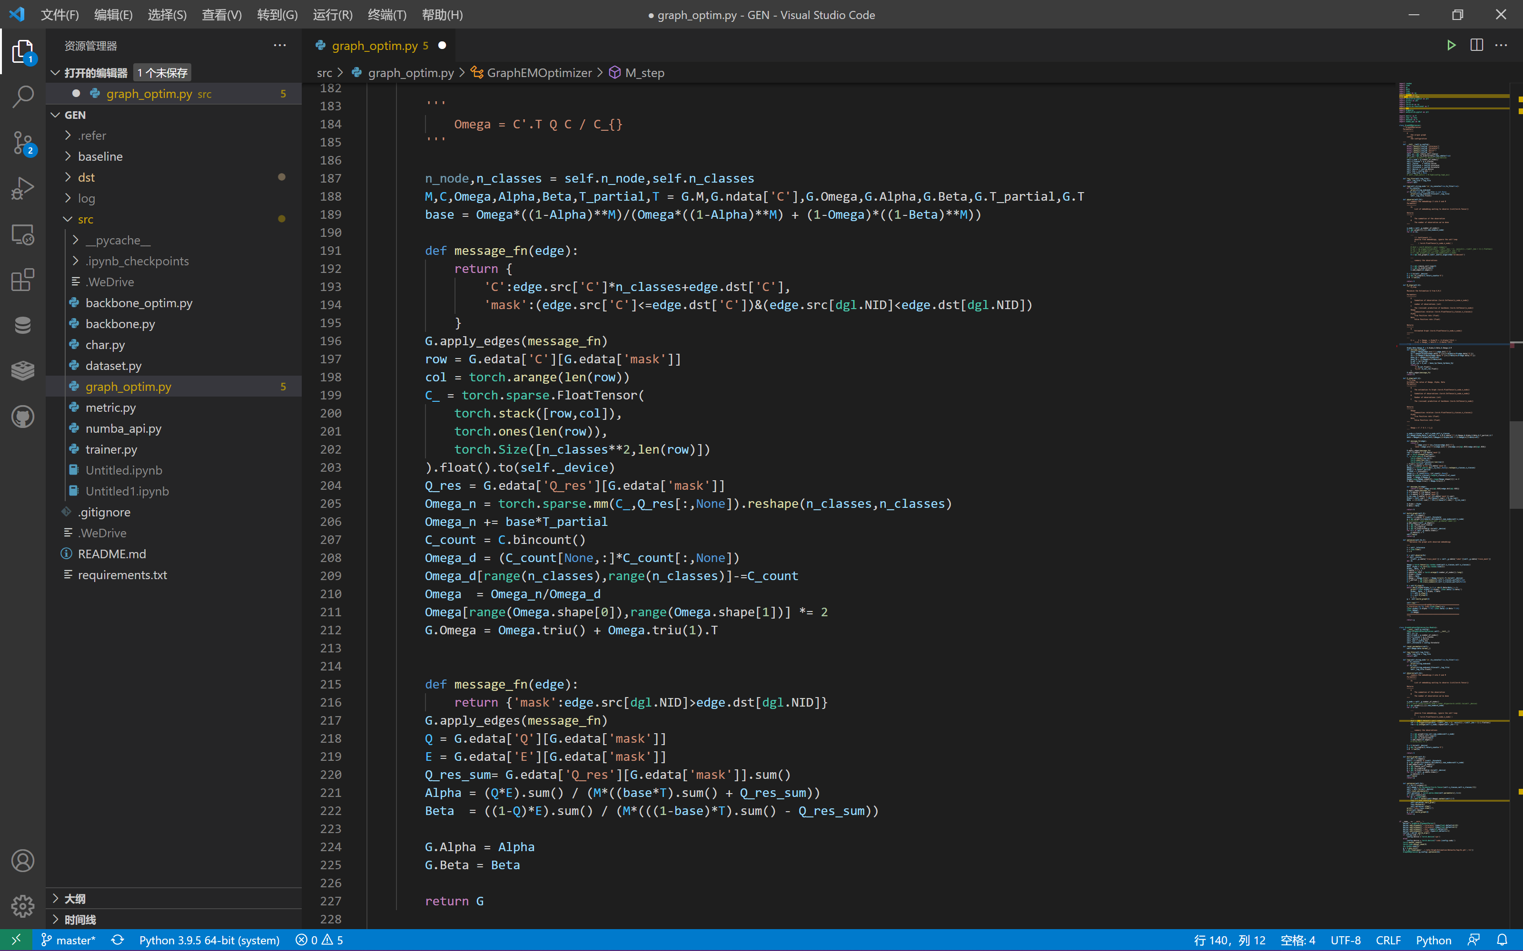
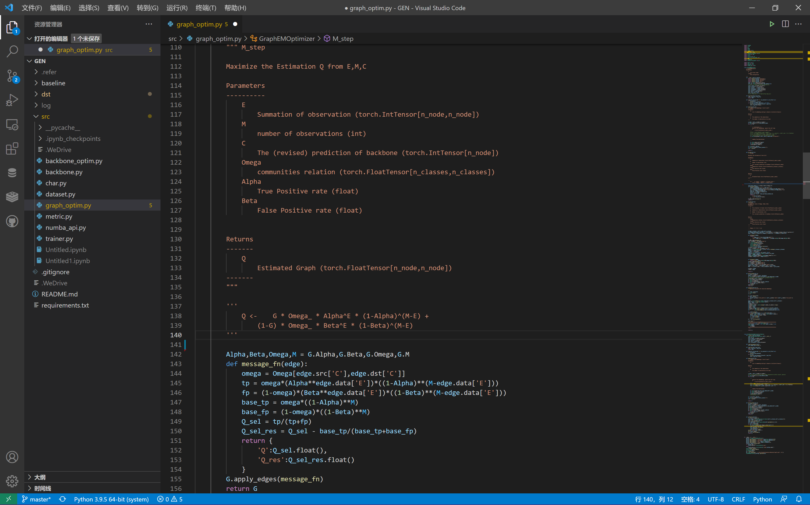
EM
附录

